Slide 1
Creativity, Innovation and Entrepreneurship & IPR

Slide 2
Creativity
Creativity is related to finding a new idea
Creativity is thinking new things, the ability to develop new ideas and to discover new ways of looking at problems and opportunities.
Creativity is the ability to make or otherwise bring into existences something new, whether a new solution to a problem, a new method or device, or a new artistic object or form.
Wyckoff (1991) defines creativity as new and useful.
Creativity is the act of seeing things that everyone around us sees while making connections that no one else has made.
Creativity is marked by the ability to create, bring into existence, to invent into a new form, to produce through imaginative skill, to make to bring into existence something new.
Creativity is not ability to create out of nothing (only God can do that), but the ability to generate new ideas by combining, changing, or reapplying existing ideas.

Slide 3
Innovation
innovation can be defined as the development of new or useful ideas by individuals, teams and organisations.
Innovation is doing new things, the ability to apply creative solutions to those problems and opportunities in order to enhance people’s lives or to enrich the society.
Innovation is defined as adding something new to an existing product or process.
The key words are adding and existing.
The product or process has already been created from scratch and has worked reasonably well. When it is changed so that it works better or fulfils a different need, then there is innovation on what already exists.
Innovation is the successful exploitation of new ideas.
All innovation begins with creative ideas. Creativity is the starting point for innovation.
Creativity is however necessary but not sufficient condition for innovation.
Innovation is the implantation of creative inspiration.

Slide 4
ENTREPRENEURSHIP
Entrepreneurship is a new idea which is conceptualized for developing or establishing business.
Entrepreneurship is the result of a process that apply both creativity and innovation to capitalize on marketplace opportunities.
Entrepreneurs are those who marry their creative ideas with the purposeful action and structure of a business.
Entrepreneurship = creativity + innovation
Sanchez (2011) defines entrepreneurship as creating opportunities which are considered after processes of identification, evaluation and developing, at the same time exploiting these opportunities with resources which can influence processes.

Slide 5
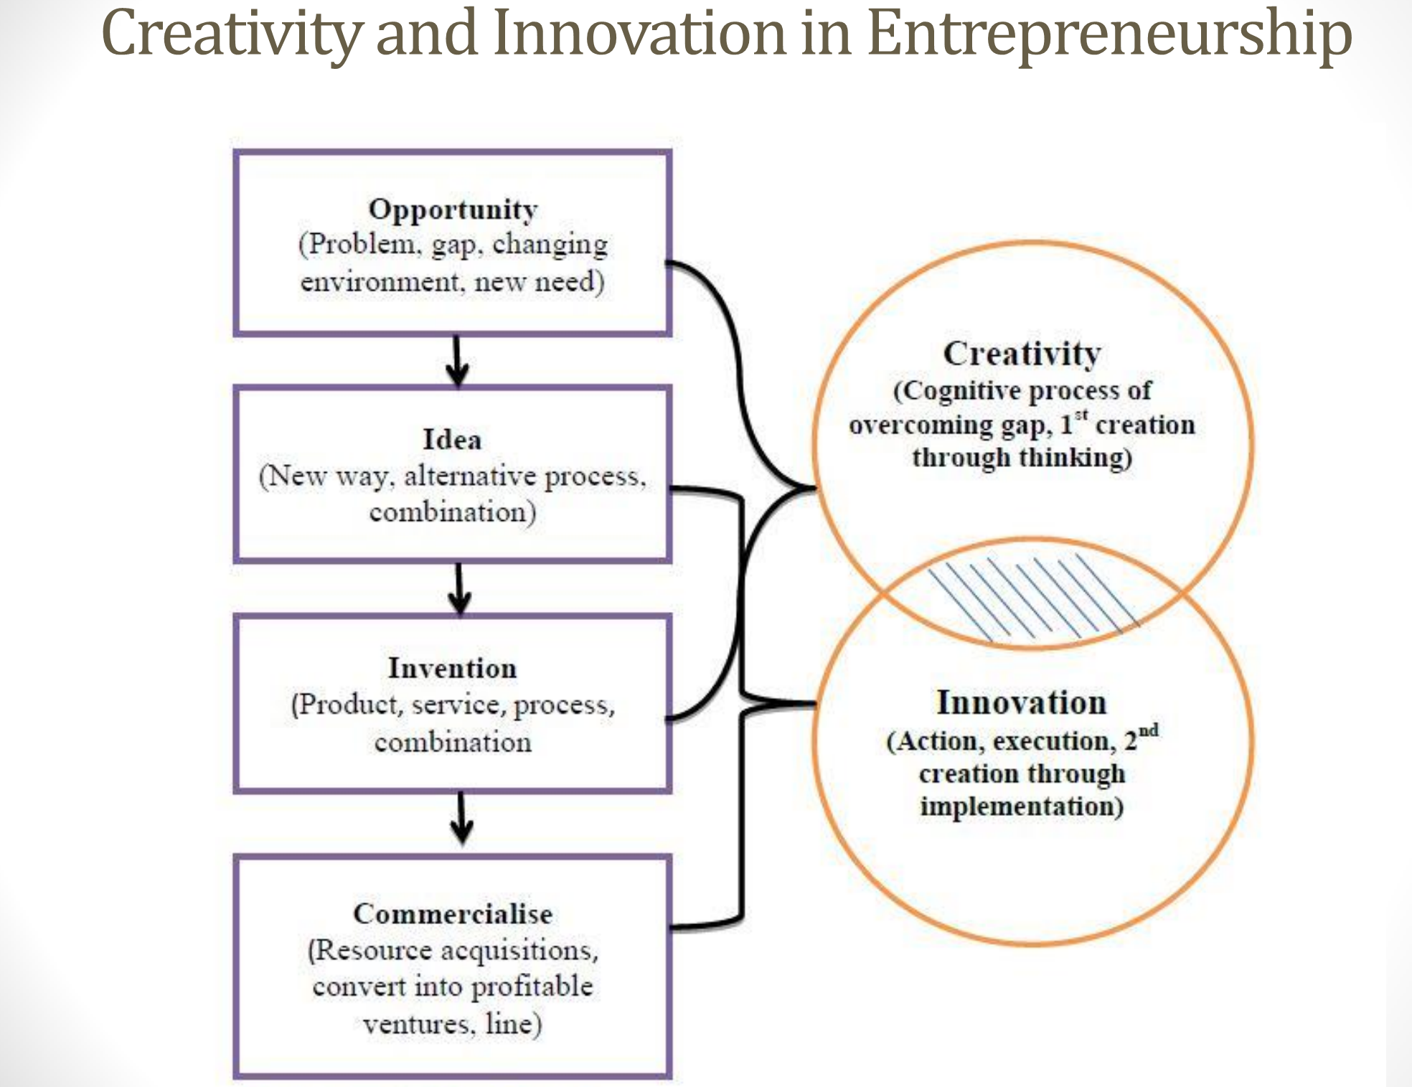

Slide 6
Barriers to innovation and creativity
1. searching for the one ‘right’ answer 2. focusing on being logical 3. blindly following the rules 4. constantly being practical 5. viewing play as frivolous 6. becoming overly specialized 7. avoiding ambiguity 8. fearing looking foolish 9. fearing mistakes and failure 10. believing that ‘I’m not creative’.

Slide 7
Four phases to avoid innovation and creativity barriers:
1. knowledge accumulation e.g. reading, professional conferences, talking, visit to library
2. incubation process e.g. ‘sleep on it’, exercise,
3. idea or ‘eureka’ experience, usually this phase slowly but surely formulates the solution
4. evaluation and implementation e.g. prototypes, advice.

Slide 8
An entrepreneur:
• introduce new goods • introduce new services • introduce new methods of production • open new markets • open new sources of supply • re-organise industry.

Slide 9
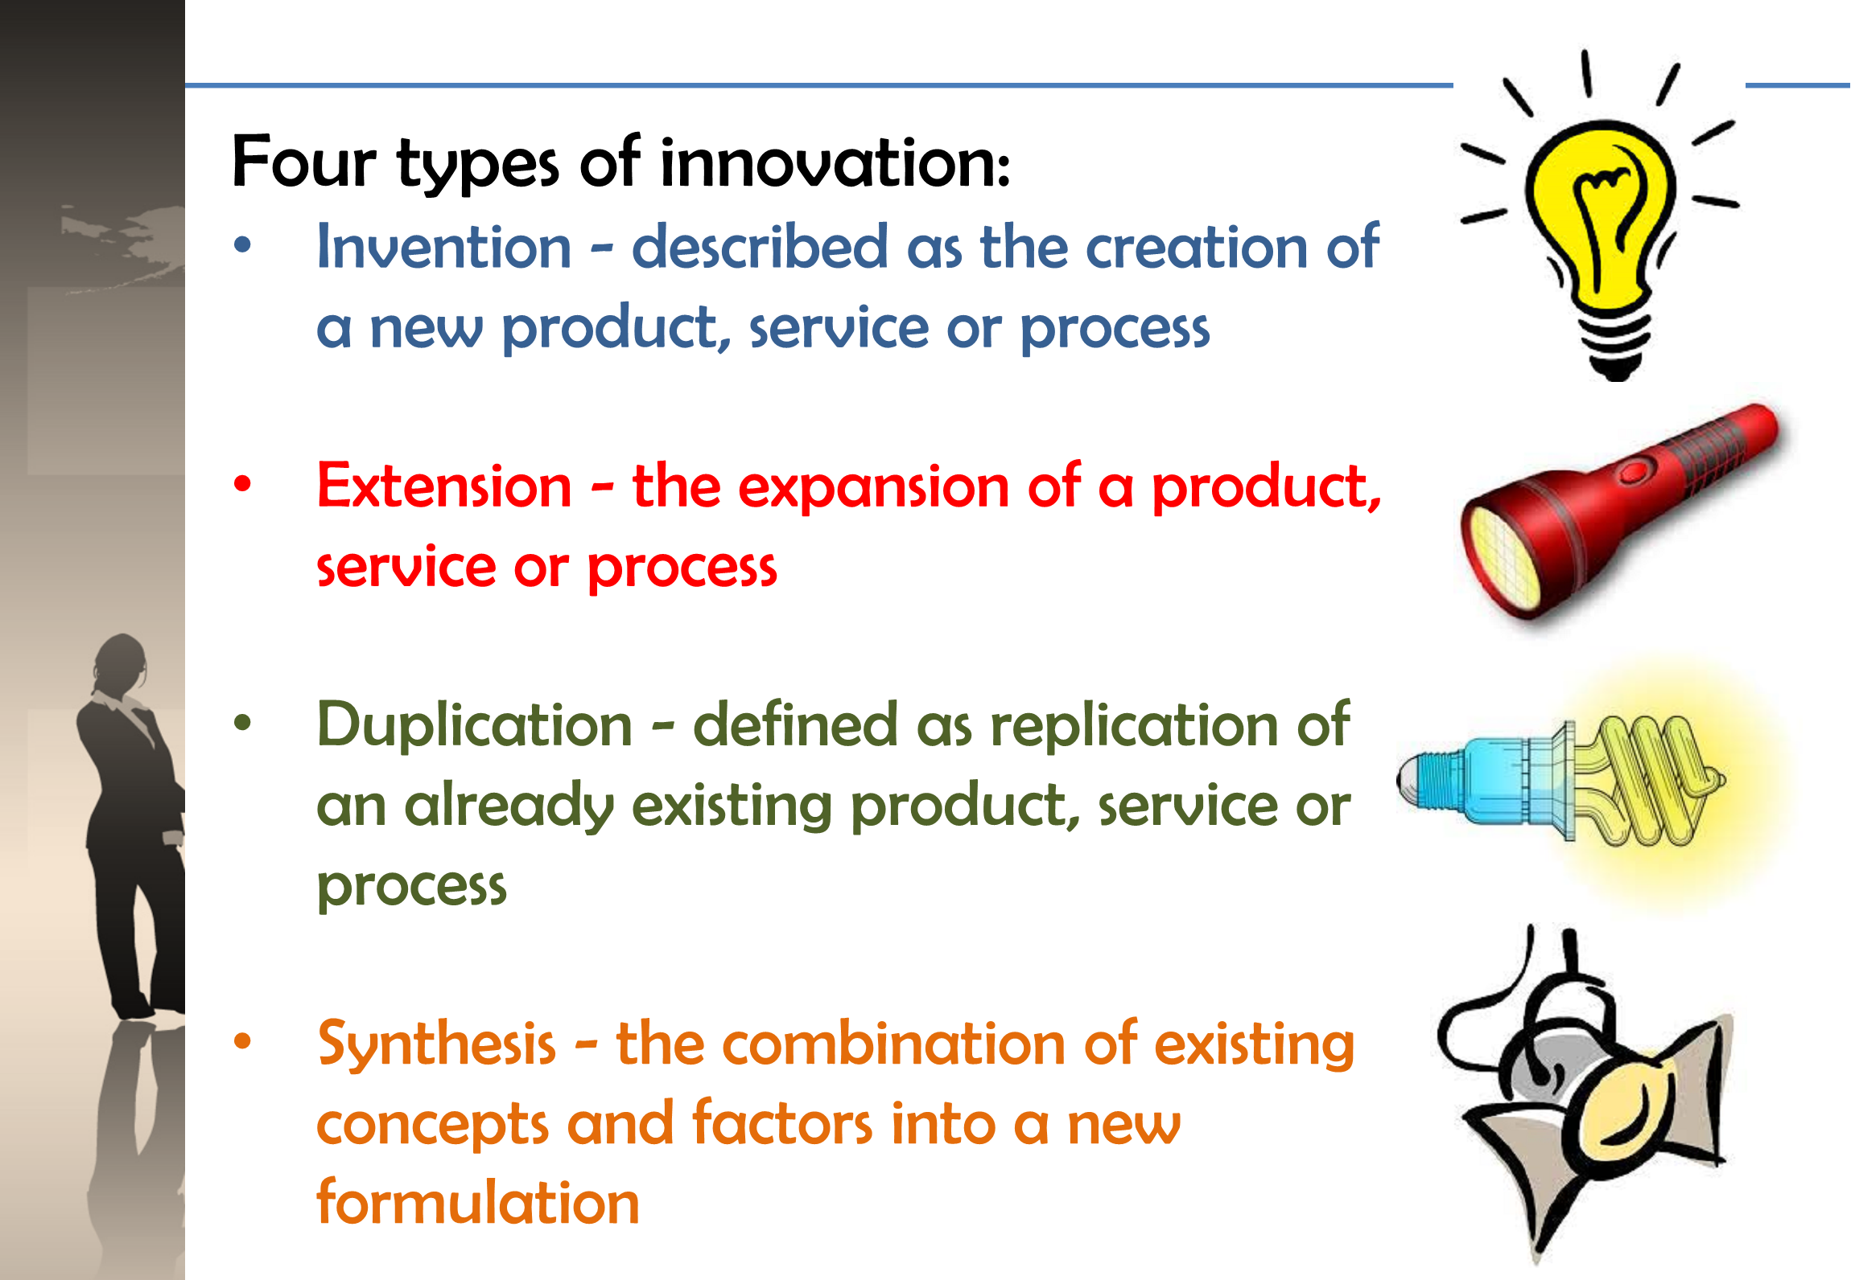

Slide 10
Five innovation myths:
• innovation is planned and predictable • technical specifications should be thoroughly prepared in advance • creativity relies on dreams and blue-sky ideas • big projects will develop better innovations than smaller ones, and • technology is the driving force of innovation and success.

Slide 11
Drivers for innovation
Financial pressures to reduce costs, increase efficiency, do more with less, etc
Increased competition
Shorter product life cycles
Value migration
Stricter regulation
Industry and community needs for sustainable development
Increased demend for accountability
Demographic, social and maket changes
Rising customer expectations regarding service and quality
Changing economy
Greater availability of potentially useful technologies coupled with a need to exceed the competition in these technologies

